Slide 1

Future of Debt

Slide 2
Equity is for Wealth Creation
&
Debt is for Wealth Protection
Notes:
This phrase does not seems to be very re-assuring to most of us here in the audience today, so what happened?

Slide 3
What happened at IL&FS?
ALM
Notes:
IL&FS is a massive infrastructure company. They build roads, power plants etc.
So suppose if there’s an infra project that IL&FS gets which is going to take 10 years to build, IL&FS would generally borrow for 10 years, using a zero coupon bond. At the 9th year IL&FS understands that the project would probably take a little more time, may be another 3 years over and above the 10 (total 13). But the bond has to be paid for at the end of the 10th year (1 year later), so IL&FS would raise another 1 year loan through the bond to pay off the principal + interest of the earlier bond. New debt is borrowed to pay the old debt and it continues
There are 2 problems now, project commissioning getting delayed and assuming that the roll over will continue.
I remember it was April 2018 when one of the 300 entities of IL&FS called the IL&FS transportation network could not make 1 payment which they termed as some technical error but the lenders got a hint of something going wrong and that's when the liquidity started freezing and boom, default!

Slide 4
What happened at DHFL?
Liquidity
Notes:
DHFL which is the 3rd largest Housing Finance Company, got hit by the liquidity crunch created after the IL&FS crises.
AAA bonds defaulting lead to a panic and on that DSP sold some 300 cr worth of bonds as high as 10.5% - 11% yields
Stock price came crashing down with fear of something wrong at DHFL and liquidity freezed for DHFL in an already difficult liquidity environment. How can a HFC survive if it cant roll over the debt?
Then cobra post happened claimed promoters siphoning off some 31,000 cr.

Slide 5
What happened at Essel?
LAS
Notes:
(1) Zee entertainment, technically is a zero debt company. But promoters dint really want to do only media and entertainment and hence diversified into Infra, D2H etc.
(2) The way Zee had borrowed for the infra business and taking over Videocon was LAS. Assuming the ratio required was 1.2, 80 rupees were given for 100 rupees of zee shares. As and when the price of the share increased, they borrowed more loan on the same shares.
(3) Unfortunately neither infra nor Videocon bet went their way. Cautious MF & NBFC’s were not lending after the IL&FS case, Rollover stopped.
(4) Promoters denied to maintain the pledged ratio and hence some lenders sold the shares bringing the stock price crashing down.

Slide 6
Now What?
DHFL & Essel have not defaulted
IL & FS
IL&FS has put 20,000 cr. worth of assets to sell
DHFL
Raising funds via securitization
Reduction in disbursements
Selling stakes across MF, Insurance and Aadhar Housing Finance
Essel
Is in discussion with media houses to sell its stake in Zee
Notes:
Money has to be paid back in case of default and liquidity has to be increased in case where there is lack of it. So what are these entities doing for the same.

Slide 7
Cumulative Default Ratings - CRISIL
10 Years cumulative default ratings (2007 – 2017)
Ratings | 1 year | 2 years | 3 years
AAA | 0.00% | 0.00% | 0.00%
AA | 0.02% | 0.10% | 0.20%
A | 0.22% | 0.98% | 1.90%
BBB | 0.84% | 2.10% | 3.89%
Notes:
We seems to have technically written off rating agencies but if you look at the last 10 years data, there has been 0 default in a AAA rated entity by CRISIL. IL&FS may be an exception and probably is not a systematic risk.

Slide 8
Recovery?
MF Investment | Recovery Rate
Amtek Auto | 85%
BILT | 80% (and counting)
JSPL | 67.5% - 75%
Notes:
Another misconception amongst us is that default means FULL money lost.
If you have taken a loan from a bank and cant pay, banks will restructure, give you some time etc., problem with MF’s is because they are investments, they have to immediately mark it down as a loss. But does that mean money is lost?
If we look at the last 3 defaults, Amtek has had a 85% recovery, means from 100 that they defaulted on, 85 is recovered, 83% is recovered and still counting in case of BILT and though technically for the investor 67.5% - 75% is recovered but JSPL has not defaulted at all making it a 100% recovery.
All we have to do is give it some time. On 100 rupees of AUM if the fund was invested 2% in a defaulting paper, the loss is 2%. If the recovery rate is 80%, means 1.6% will be recovered and the net loss would only be 0.4%

Slide 9
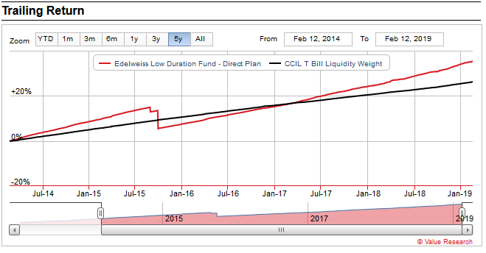
What after MF write downs? – Amtek Auto
Notes:
Yes the fund took a beating when Amtek defaulted but had we held it, look at it today.

Slide 10
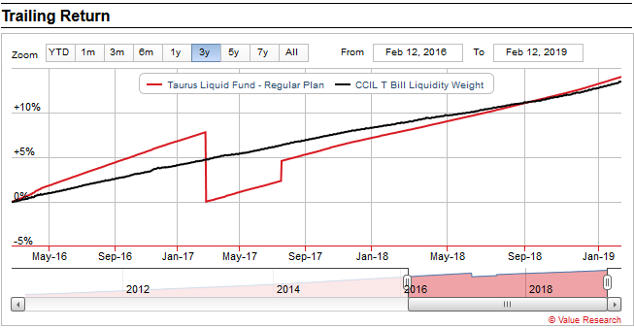
What after MF write downs? – BILT
Notes:
Yes the fund took a beating when BILT defaulted but had we held it, look at it today.

Slide 11
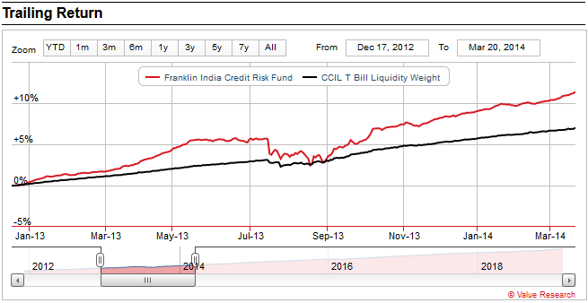
What after MF write downs? – JSPL
Notes:
Yes the fund took a beating when JSPL defaulted but had we held it, look at it today.

Slide 12
What should we do?
Requirement | Action
Immediate (3-6 months) | SELL
Later (3 years) | HOLD
Notes:
If the client needs the money in another 3-6 months, sell the affected fund and liquidate. If the client can stay put for 3 years, hold on.

Slide 13
Debt Funds – Ownership vs Opportunity
Notes:
There is a huge potential and a very strong business case in advising debt. Today most of us here are grappling with common issues,
Getting new clients
Making sure the client stays the course of the investment
Ticket Size
Commissions
Advising Debt is the perfect solutions

Slide 14
Case for Debt
Client Acquisition
First Time
Lower Risk Profile
Asset Allocation
Goal Based
Risk Profile Based
Predictability
Return
Risk
Business Perspective
Bigger ticket size
Equivalent holding period
Notes:
Average Retail Ticket size in equity is 1.3 lakhs
Average Retail Ticket size in Debt is 3.6 Lakhs. Almost 3 times
29% of equity investments are help beyond 2 years and close to 22% in debt is help for beyond 2 years.

Slide 15
Thank You

