Slide 1
Lulu for Cafémutual
21st February 2019, Taj Lands End

Slide 2
What do you think is your most valuable asset?

Slide 3
Your personal brand

Slide 4
What is your personal brand made up of?

Slide 5
Your Name? Your Business Card? How you market yourself? Articles written about you?

Slide 6
It’s all of those but actually none of those.

Slide 7
Walter Landor once said:

Slide 8
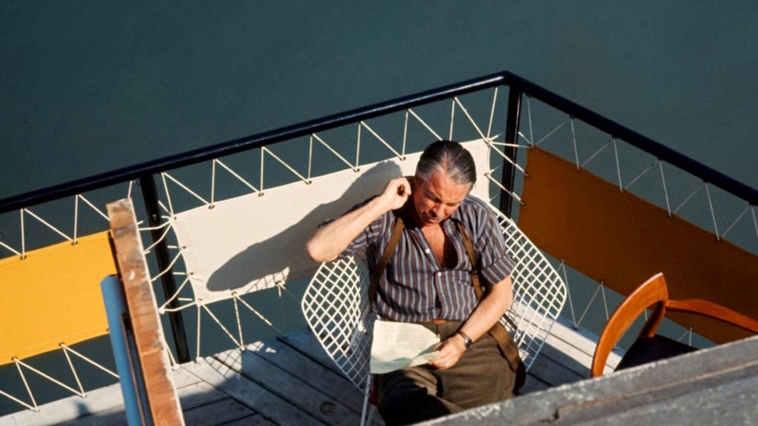
Products are built in the factory; but brands are created in the mind.” – Walter Landor

Slide 9
BRAND
is about associations

Slide 10
Story
BRAND
Purpose
Positioning
Personality
Notes:
It’s not what you say you are, it’s what they say you are.

Slide 11
Story
Name
Business Card
Website
LinkedIn Profile
Google Search Results
Digital footprint on social – Facebook, Twitter, Instagram, Snapchat, Pinterest, Medium, Tumblr, Youtube, Vine, Vimeo, Flipboard etc.
Published Articles
Appearance – Shoes, Clothes, Accessories, Hairstyle…
Way you speak – voice and words
Handwriting
Body language
Photographs in public domain
Word of mouth
Handshake
BRAND
ING
Signals
The sum-total of all experience touchpoints.
Notes:
It’s not what you say you are, it’s what they say you are.

Slide 12
Brand = reputation
Notes:
It’s not what you say you are, it’s what they say you are.

Slide 13
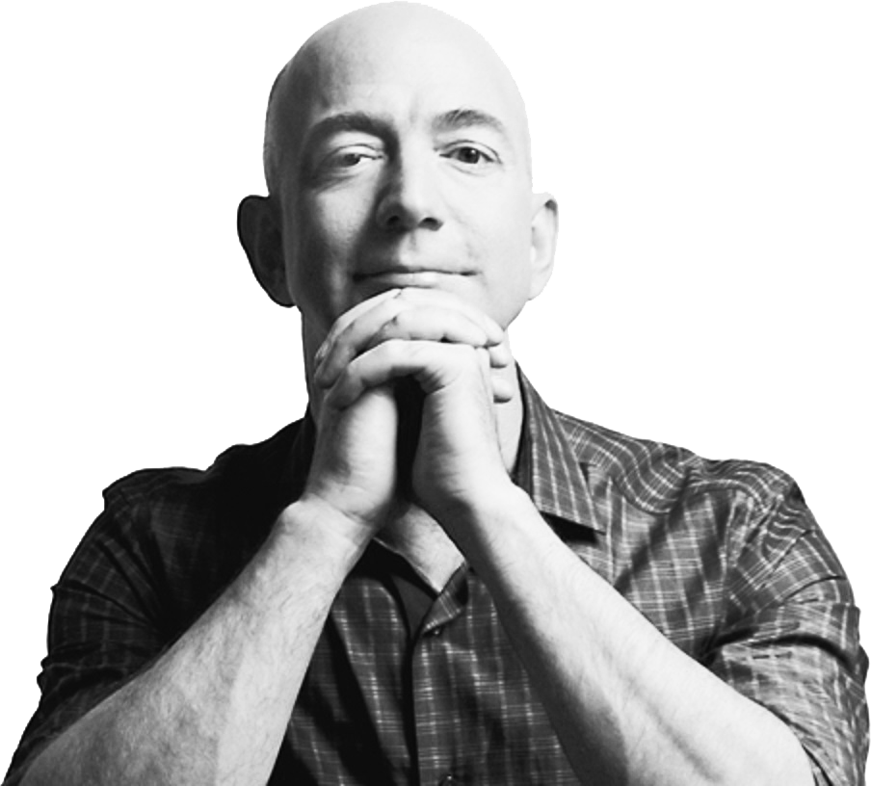
Your brand is what people say
when you are not in the room - Jeff Bezos

Slide 14
What do these 3 people have in common?
Notes:
Well sure they’re all successful, visible, rich and famous, but there is one immense underlying factor that supersedes all of those things: each of them has found, embraced, and capitalized on their own personal brand

Slide 15
They are strong and unwavering persona brands.
Challenging viewers to live the best lives possible by understanding their own potential.
Staying true to his core values, including adventure, excitement and risk-taking.
Sportsmanship, commitment and humility in the face of extreme greatness
Notes:
Well sure they’re all successful, visible, rich and famous, but there is one immense underlying factor that supersedes all of those things: each of them has found, embraced, and capitalized on their own personal brand

Slide 16
Personal branding is about how you’re remembered as an individual.

Slide 17
POSITIONING
How you are relevant to customers in a way that is different from others.

Slide 18
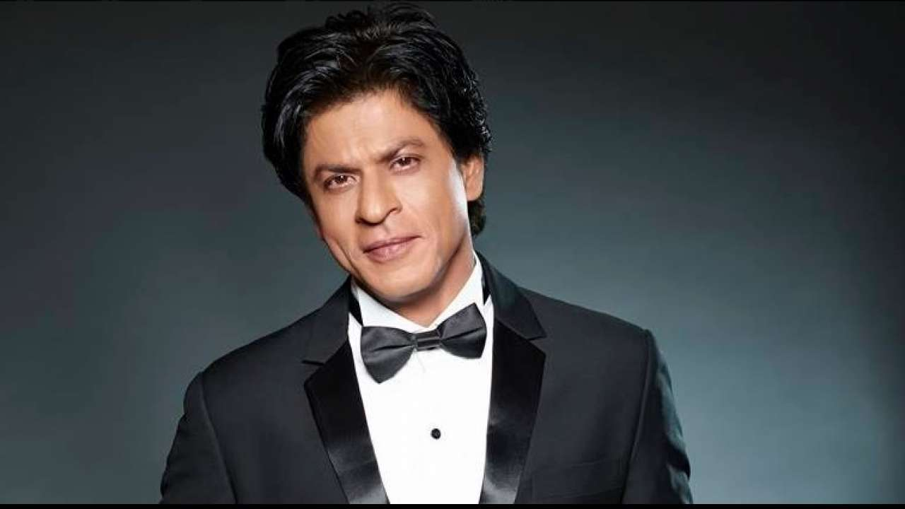
The Romantic

Slide 19
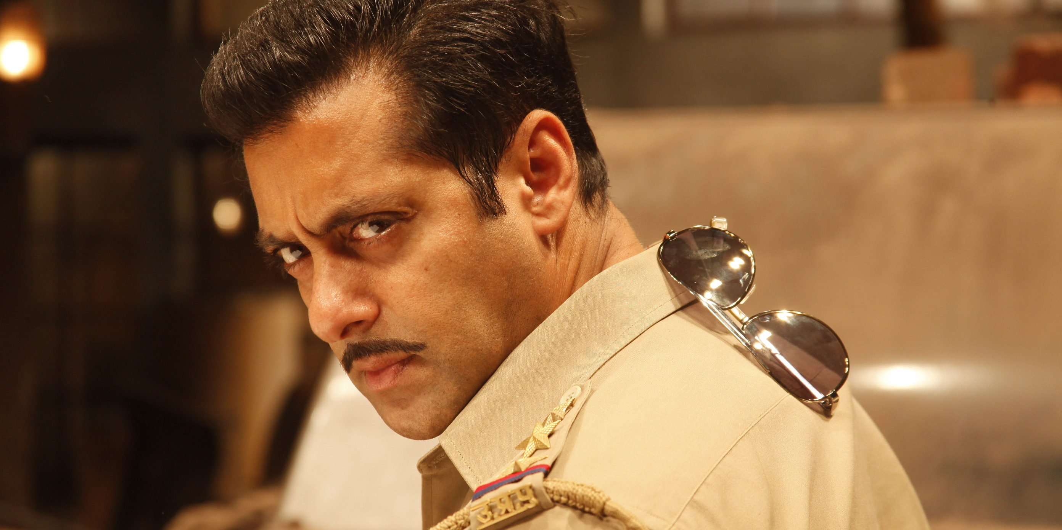
The Man of the Masses

Slide 20
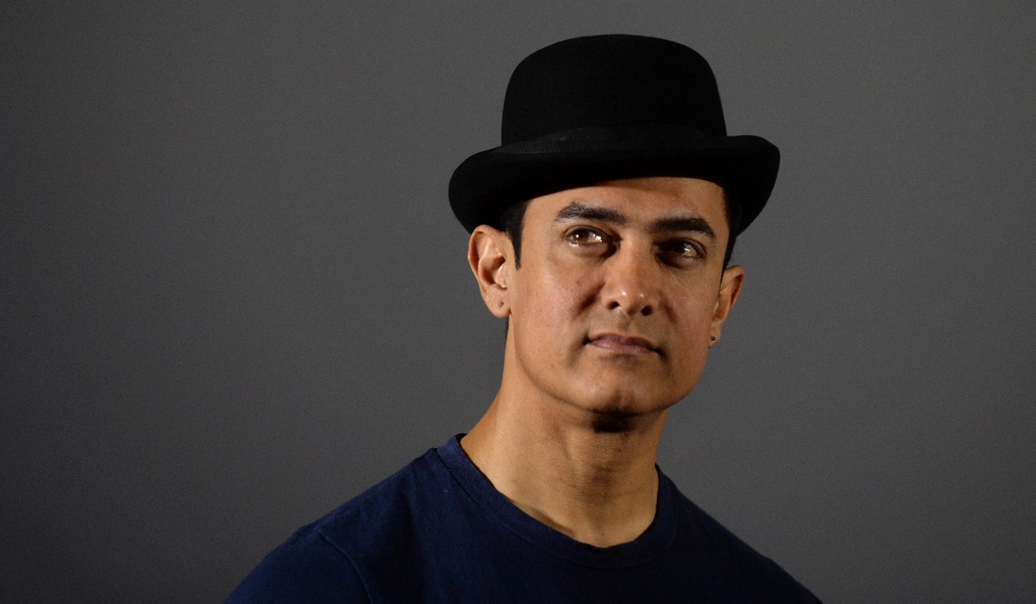
The Intellectual

Slide 21
ASK YOURSELVES
IS EVERYTHING YOU DO ALIGNED WITH WHAT YOU WANT TO STAND FOR?
Notes:
Any guesses?

Slide 22
BENEFITS OF HAVING A CLEAR POSITIONING
DISTILLS WHO YOU ARE
ARTICULATES YOUR POINT OF DIFFERENTIATION
EASY TO UNDERSTAND IMMEDIATELY
Notes:
Invaluable – to understand your brand immediately. An easy induction for new employees in a fast growth environment

Slide 23
COST OF NOT HAVING A CLEAR POSITIONING
PEOPLE DON’T UNDERSTAND YOU
LACK OF DIFFERENTATION
FROM OTHERS
Notes:
One of the top five reasons why people did not buy from you was because they did not understand what you stand for.

Slide 24
WRITE YOUR
ELEVATOR PITCH
You are in a job interview and the interviewer says, "Tell me about yourself.”
Write a short, descriptive, and powerful positioning statement for yourself. No more than 10 words.
Skills
Strengths
Elevator pitch
Credibility
Values

Slide 25
#1 How you dress.

Slide 26
Notes:
Did any of you watch the royal wedding

Slide 27
#2 How you speak.

Slide 28
Notes:
Video of stand up comedian talking about difference between Indian news channels and English news channels.

Slide 29
#3 How you write emails.

Slide 30
1
2
Notes:
– including your comments on others’ posts etc

Slide 31
#4 How to build your brand using social media.

Slide 32
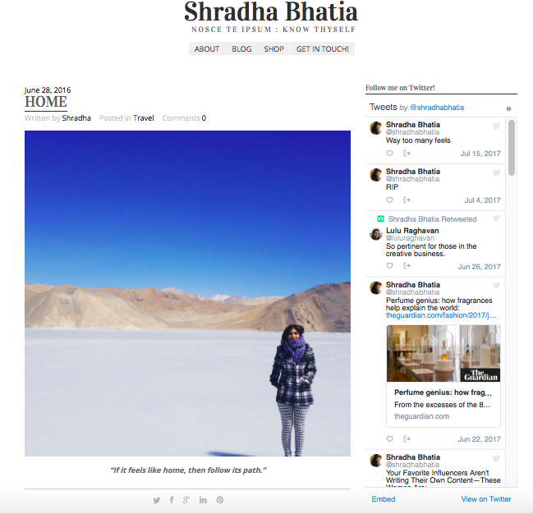
Notes:
ncluding your comments on others’ posts etc

Slide 33
10 Thought Starters for Building your Personal Brand Remember, building a brand is like raising a child.

Slide 34
The Ripple Effect
(thanks, Greg Well)

Slide 35
Feed your mind. Garbage In. Garbage Out.

Slide 36
Feed your soul and spirit. Culture, Religion, Meditation.

Slide 37
Define an Intent/Vision/Dream for you at work

Slide 38
Develop and nurture your persona

Slide 39
You have a voice. Use it.

Slide 40
Step out of your comfort zone to grow.

Slide 41
Lead with your natural style. Don’t pander to a stereotype of a boss or manager.

Slide 42
Promote yourself

Slide 43
Promote and Mentor others. Men & Women.

Slide 45
Let’s discuss!

Slide 46
Be fearless. You’re warriors.
Thank You

