Slide 1
Presented by :
MR. MAHESH GATTANI
Awarded Best Financial Advisor by CNBC TV 18

Slide 2
JOURNEY BEGINS
JUL 1994
Start
IPO Sub-Broker
1995
Secondary Market Sub-Broker
2019
We are Here
Appointed As District Representative of Kothari Pioneer
A 10%+ market share of MF AUM in city, 1500+ clients
DEC 1995

Slide 3
FIRST MILESTONE - 500 SIP
Idea Generation
- 20 September 2016; Cafe Mutual Conference at Hotel Lalit, Mumbai
Discussion with Team
- Feasibility
Ground level preparation
Discussion with Investors
- Share the thought with all investor
- Convince them for their share of SIP
Ground Work
- Leaflets on SIP in regional languages
- Prepare material on SIP with Bank RD
- Comparison of SIP with Life Insurance Policy

Slide 4
My own example on the power of SIPs....
WF : You often give your clients even today, your own example of the power of SIPs....
Mahesh Gattani : Yes, I started my SIPs in Franklin Bluechip, Tax Shield and Pension Plan in 1996 - Rs. 1000 per month in 3 names. Later, from 2004, I started investing Rs. 5000 per month in each name.
My father was initially not very happy with SIPs - he preferred earning regular interest. But, I kept up the SIPs anyway. By early 2008, when I wanted to buy an attractive piece of land in an upcoming area of Amravati, I was able to withdraw Rs. 50 lakhs from my Mutual Fund Investments through SIPs to finance that purchase.
Today, with God's grace, that has also appreciated very well. I am able to show that land today and actually show the power of wealth creation of small amounts of SIPs that are maintained for long term.

Slide 5
My own example on the power of SIPs....
Started my SIPs in Franklin Bluechip, Tax Shield and Pension Plan in 1996 - Rs. 1000 per month in 3 names.
Later, from 2004, I started investing Rs. 5000 per month in each name.
Withdraw Rs. 50 lakhs from my SIPs to finance an attractive piece of land in year 2008
SIP PERFORMANCE FROM 01/01/1996 TO 31/12/2007
SR NO | SIP START DATE | SIP END DATE | SCHEME NAME | SIP AMOUNT | INVESTED AMOUNT | VALUATION AS ON 31/12/2007 | CAGR RETURN
1 | 01/01/1996 | 31/12/2003 | FRANKLIN INDIA BLUECHIP FUND-GR | 1,000.00 | 96,000.00 | 9,71,373.00 | 30.37%
2 | 01/01/1996 | 31/12/2003 | FRANKLIN INDIA TAXSHILED FUND-GR | 1,000.00 | 57,000.00 | 5,28,524.00 | 39.27%
3 | 01/01/1996 | 31/12/2003 | FRANKLIN INDIA PRIMA FUND–GR | 1,000.00 | 96,000.00 | 18,96,000.00 | 39.87%
4 | 01/01/2004 | 31/12/2007 | FRANKLIN INDIA BLUECHIP FUND–GR | 5,000.00 | 2,40,000.00 | 5,79,862.00 | 46.96%
5 | 01/01/2004 | 31/12/2007 | FRANKLIN INDIA TAXSHILED FUND-GR | 5,000.00 | 2,40,000.00 | 5,71,504.00 | 46.12%
6 | 01/01/2004 | 31/12/2007 | FRANKLIN INDIA PRIMA FUND–GR | 5,000.00 | 2,40,000.00 | 5,78,496.00 | 46.82%
 |  |  | TOTAL |  | 9,69,000.00 | 51,25,759.00

Slide 6
THE DAY
SEP 23, 2017
We started at 5.00AM
2 team members processing the transactions and 2 members ( Including me ) continuously calling investors for accepting the link.
Score card from NSENMF (Minutely updated) Confirmation from investors for acceptance of transaction
30 % SIP in Debt Funds
Fruitful day ends at 5.00 PM

Slide 7
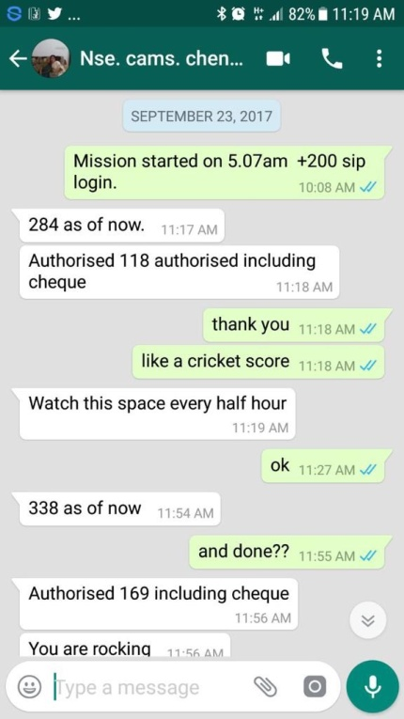
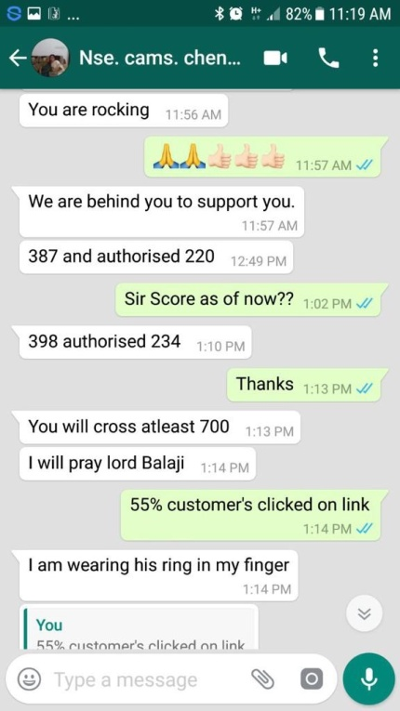
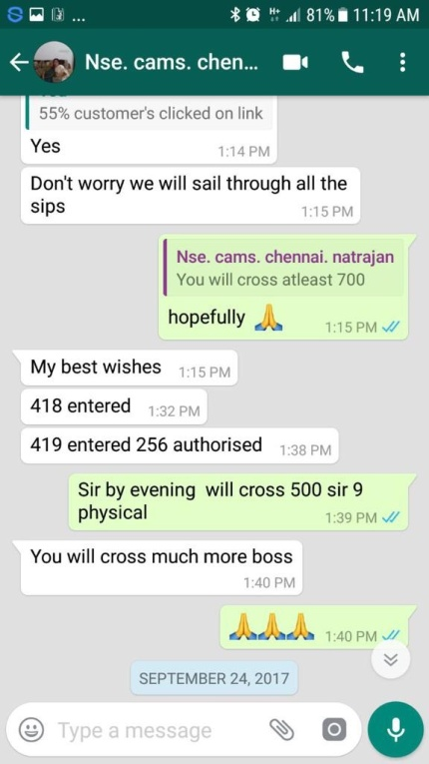
500 SIP IN A DAY
We made it Possible

Slide 8
CHILDRENS DAY
4
Digital IIN were registered before the day
72 Unique Children’s SIP
Avg Ticket Size – 4000/-
Beyond Barriers

Slide 9
WOMEN’S DAY
Targeted the women investors
Ground reality is very scary
Concentrated on SIP Value
Logged SIP of Rs 13.67 Lacs
Total 95 SIP logged

Slide 10
Our SIP Figures
As on 31 March 2017 - Rs.54,22,000/- per month
As on 31 March 2018 - Rs.1,04,66,000/- per month
As on today SIP No. - Rs.1,15,60,000/- per month

Slide 11
5
“DIGITAL TRANSFORMATION allows people to solve their traditional problems.
And they prefer this digital solution to the old solution.”
Mr. Mahesh Gattani

Slide 12
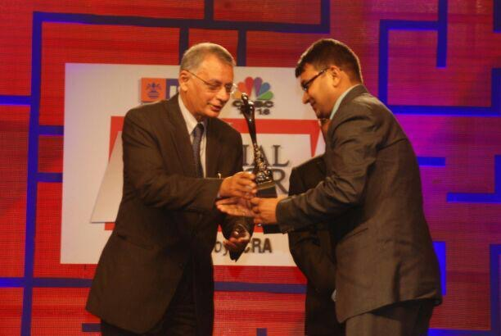
AWARDS
4
Awards and Recognition we have received
UTI MF & CNBC TV 18 Best Financial Advisor Award from Up Country West ( Maharashtra, Gujrat & Goa)
500 SIP Registration on NSENMF platform in single day - Oct 2017.
Awarded from MFRT in Aug 2018 at New Delhi for Digitalization

Slide 13
UTIMF - CNBC TV18 Best Financial Advisor Awards 2010
4

Slide 14
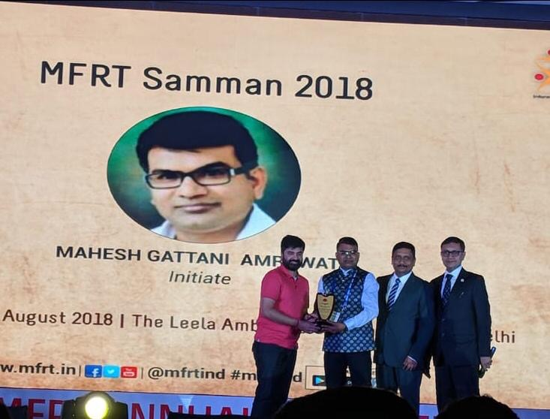
MFRT SAMMAN AWARD - 2018
4

Slide 15
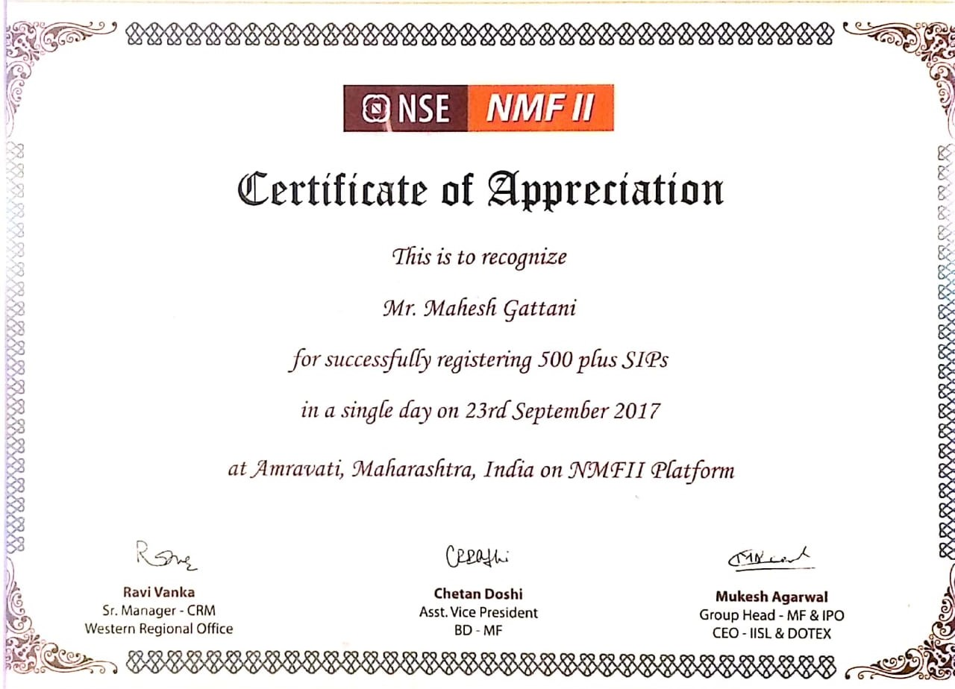
NSENMF CERTIFICATE FOR 500 SIP
4

Slide 16
“It is not necessary to do extraordinary things to get extraordinary results.”
- Warren Buffett

Slide 17
THANK YOU !

